Slide 2

Food Bridge
LINKING HUNGER TO HOPE
Suhrud Korgaokar-334
Neha Gade-325
Aditya Kothari-329

Slide 3
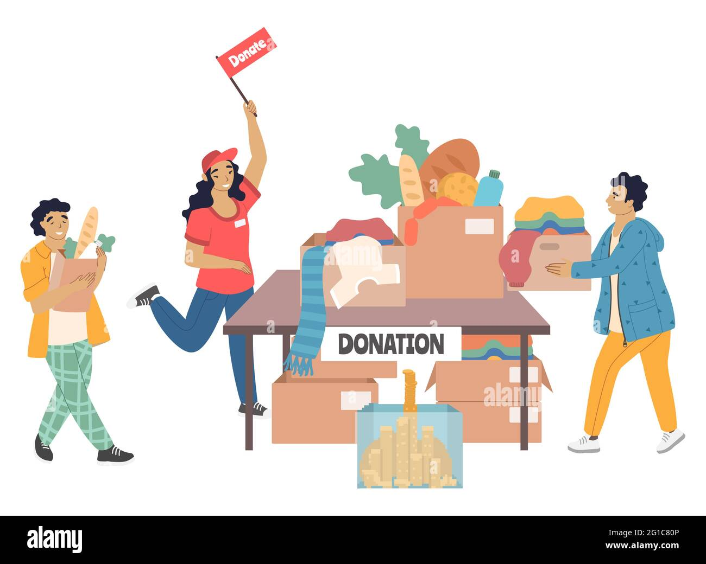
Problem statement
We aim to develop a digital platform facilitating seamless food donation, pickup scheduling, inventory management, and transparent redistribution for
charitable organizations, aiming to reduce waste and aid communities in need.

Slide 4
PROBLEM OBJECTIVE
Facilitate User Registration and Login:
Allow users to register on the platform and login to access services, ensuring a smooth user experience.
Provide Information:
Offer information about the organization and its mission through the "About Us" section, establishing transparency and building trust with users.
Enable Volunteer Sign-up:
Allow individuals interested in volunteering to sign up through the volunteer form, expanding the pool of potential volunteers and supporters.
View Volunteer Details:
Allow administrators to view volunteer information from the admin side, facilitating coordination and management of volunteer activities.
FAQ Section:
Provide answers to frequently asked questions (FAQs) to address common queries and provide clarity to users.
Home Page:
Serve as a central hub for users, featuring updates, news, and events related to the organization's activities.

Slide 5
Hardware & Software REQUIREMENTS
Html
CSS
Javascript
Web
server
php
Bootstrap

Slide 6
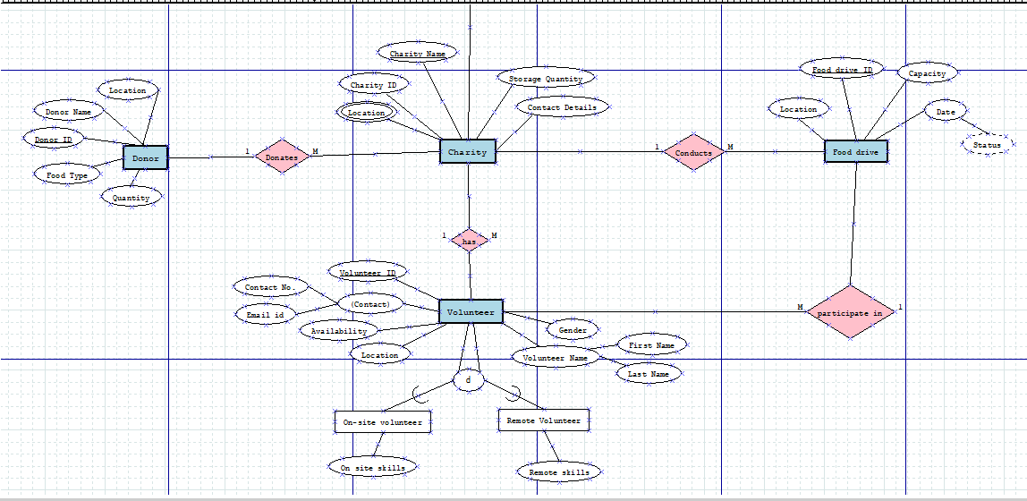
ER DIAGRAM

Slide 7
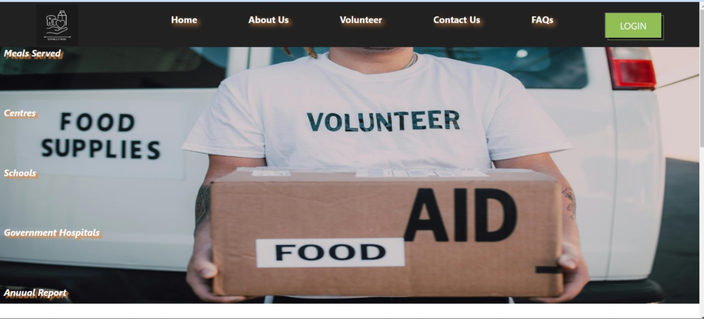
IMPLEMEnTATION

Slide 8
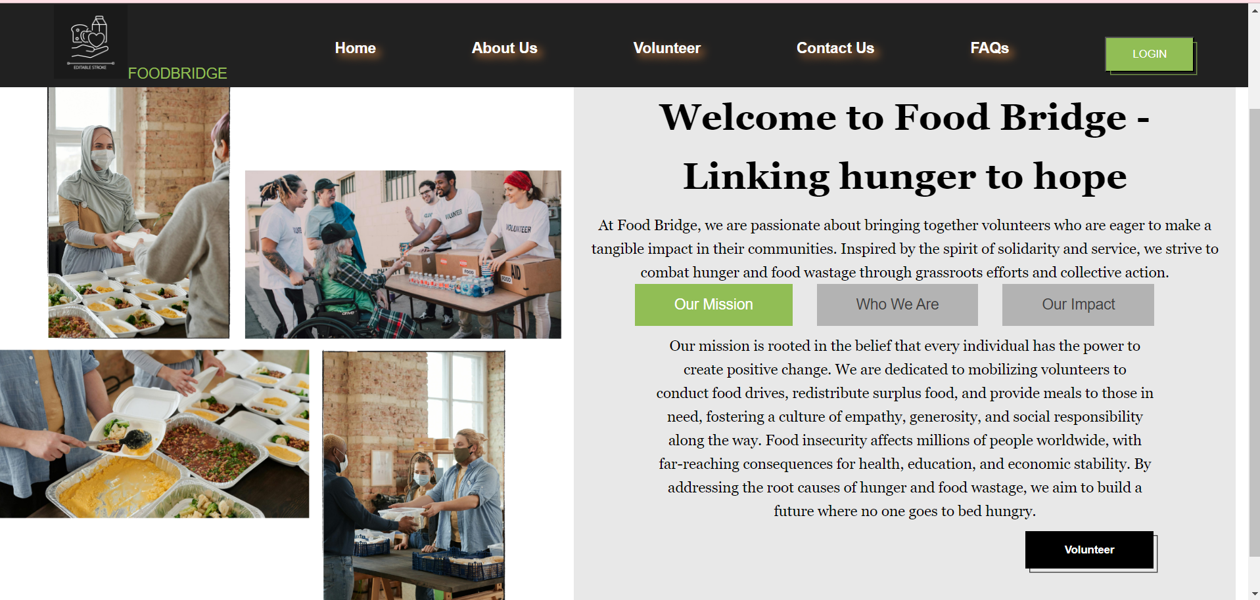
IMPLEMEnTATION

Slide 9
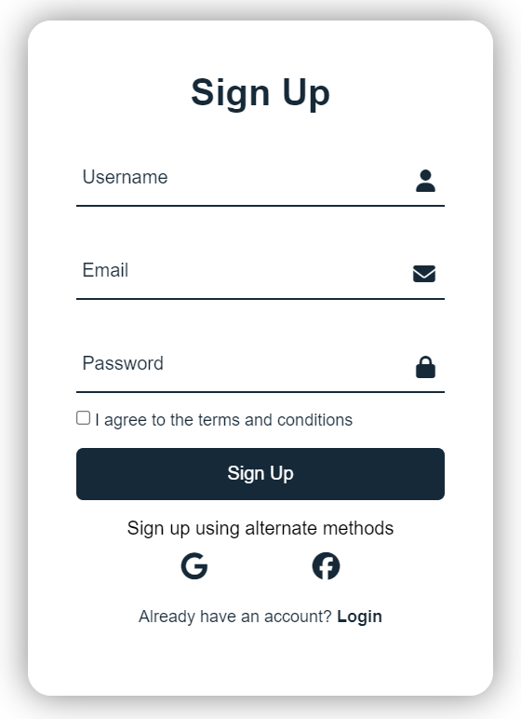
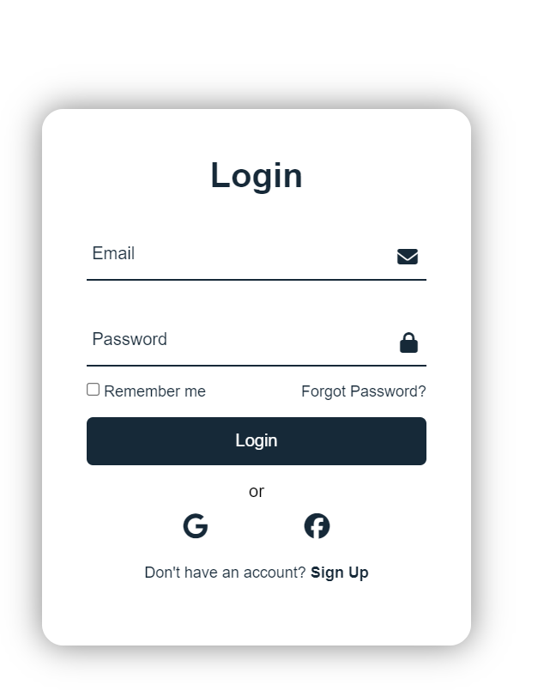
IMPLEMEnTATION

Slide 10
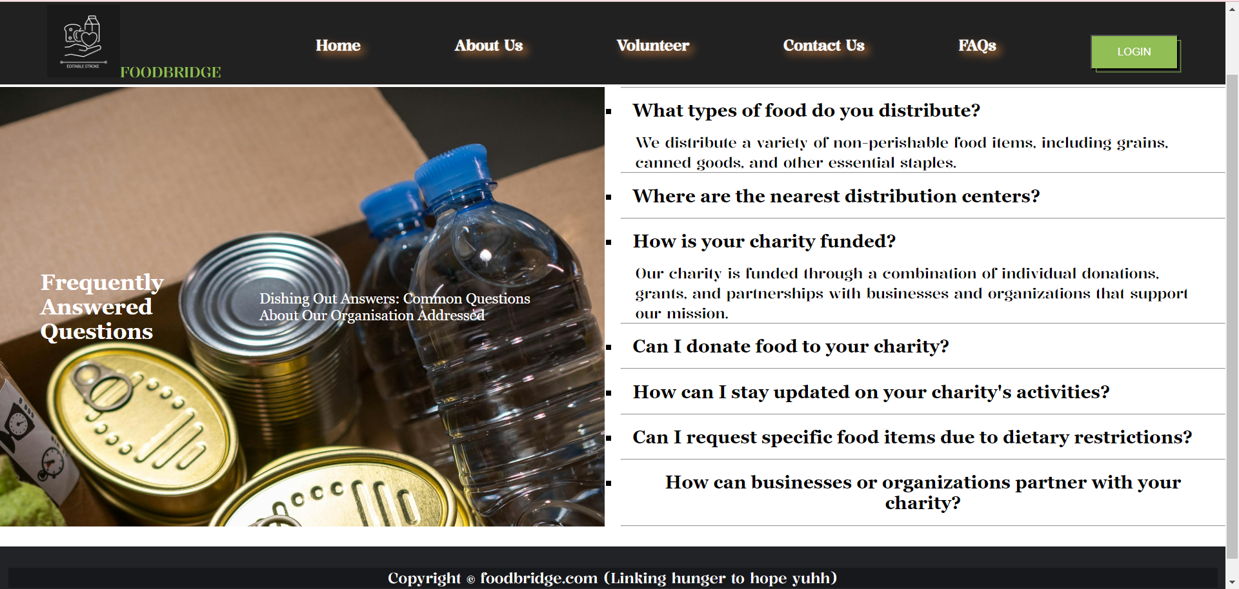
IMPLEMEnTATION

Slide 11
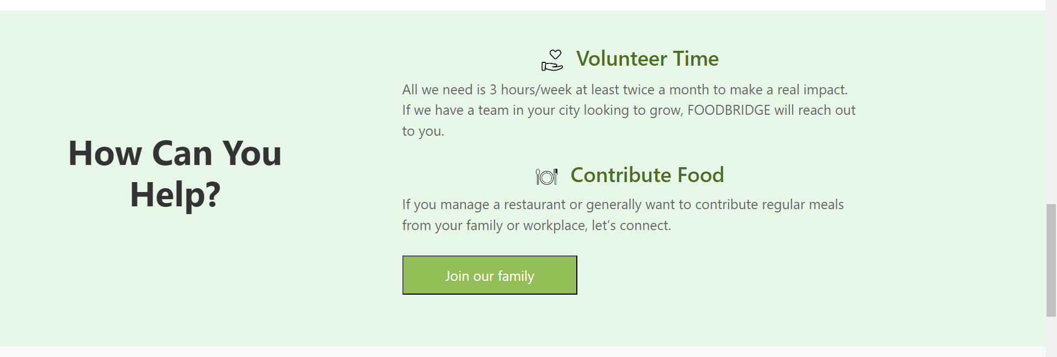
LIST OF DELIVERABLES
Food Distribution System
Volunteer data and status
User authentication for added security.
Backend server infrastructure ensuring smooth performance.
Development of responsive and intuitive user interfaces for donors, charities, and administrators.

Slide 12

REFERENCES
https://www.sciencedirect.com/science/article/pii/S1877050923001291
https://www.sciencedirect.com/science/article/pii/S1319157818309406
https://iopscience.iop.org/article/10.1088/1757-899X/407/1/012018/meta

Slide 13
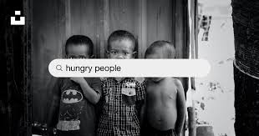
THANK YOU

